Slide 1
Advance Visual Perception :
Scene Understanding
Name : Riddhick Dalal External Guide : M Swapna (Scientist ‘E’)
Internal Guide : Dr. Debasish Pradhan

Slide 2
Problem Statement
Develop a system to extract details from aerial images/videos and process it further to perform complex reasoning and understanding.
It combines object detection, tracking, depth estimation, motion prediction, relational reasoning of recognised objects, inference of spatial and contextual relationships.

Slide 3
Literature Study :
Paper | Methodology
de Curtò J, de Zarzà I, Calafate CT. Semantic Scene Understanding with Large Language Models on Unmanned Aerial Vehicles. Drones. 2023; 7(2):114. https://doi.org/10.3390/drones7020114 | Combined the features from YOLO and CLIP to get better contextual information and then used that as input to GPT3 for detailed description generation from video
Y. Zhao et al., "Enhanced Scene Understanding and Situation Awareness for Autonomous Vehicles Based on Semantic Segmentation," in IEEE Transactions on Systems, Man, and Cybernetics: Systems, vol. 54, no. 11, pp. 6537-6549, Nov. 2024, doi: 10.1109/TSMC.2024.3403859. | Used Semantic Segmentation, Motion Estimation, Scene Complexity Analysis for advance situation awareness in autonomous vehicles
Yuansheng Hua, Lichao Mou, Jianzhe Lin, Konrad Heidler, Xiao Xiang Zhu, Aerial scene understanding in the wild: Multi-scene recognition via prototype-based memory networks, ISPRS Journal of Photogrammetry and Remote Sensing, Volume 177, 2021, Pages 89-102, ISSN 0924-2716, https://doi.org/10.1016/j.isprsjprs.2021.04.006. | Extracts features from single-scene images, stores each class’s average feature as a prototype in memory and then uses multi-headed attention to match new images against the prototypes to predict all scenes present

Slide 4
General Approach
2.Object Tracking
6. Motion Estimation
3. Spatial Features Extraction
1.CNN / Transformer
Object Detection
7. Final Scene Understanding
4. Contextual Information Extraction
5.Pattern Recognition

Slide 5
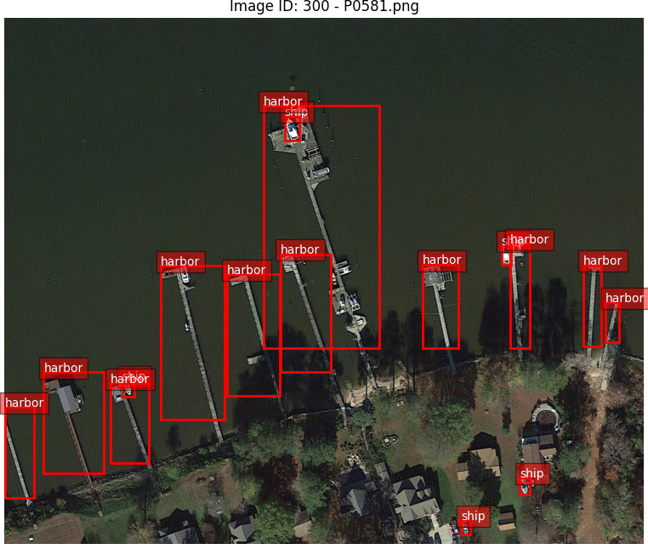
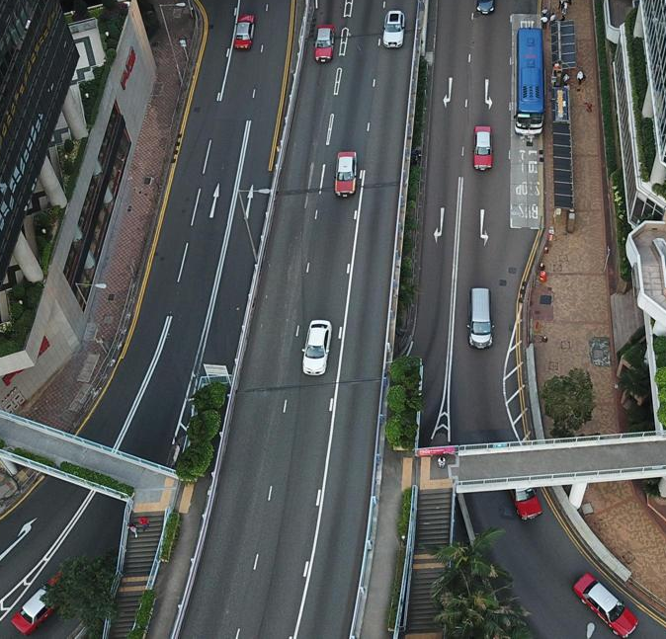
Progress
Dataset identification : VisDrone , DOTA

Slide 6
Object Detection Model Selection :
Model | Architecture | Speed | Accuracy | Use case
Yolov8 | CNN - Single Stage | Fast | Good | Real-time detection
DETR | Transformer | Slow | Very High | Complex structure scenes, relations
RetinaNet | CNN - Single Stage | Medium | High | Dense object detection
Mask R-CNN | CNN - Two Stage | Slow | Very High | Pixel level segmentation

Slide 7
Thank You

